Slide 1
Holidays abroad
Автор проекта: Денисова Анастасия,
учащаяся 7а класса
Наставник проекта: Зайцева Елена Васильевна,
учитель английского языка

Slide 2
Цель проектной работы:
расширение кругозора учащихся, создание электронной презентации и ЭОР по страноведческому материалу «Каникулы за границей».
Задачи:
1. Изучить материал Интернет-сайтов о наиболее посещаемых туристами местах англоговорящих стран;
2. Проанализировать полученные данные.
3. Составить краткий текст по теме для последующего его использования в электронной версии.
4. Подобрать к тексту соответствующие иллюстрации для обеспечения наглядного восприятия образа.
5. Оформить презентацию и электронную версию материала.
6. Апробировать использование полученной электронной версии на учебных занятиях в 7 классе.

Slide 3
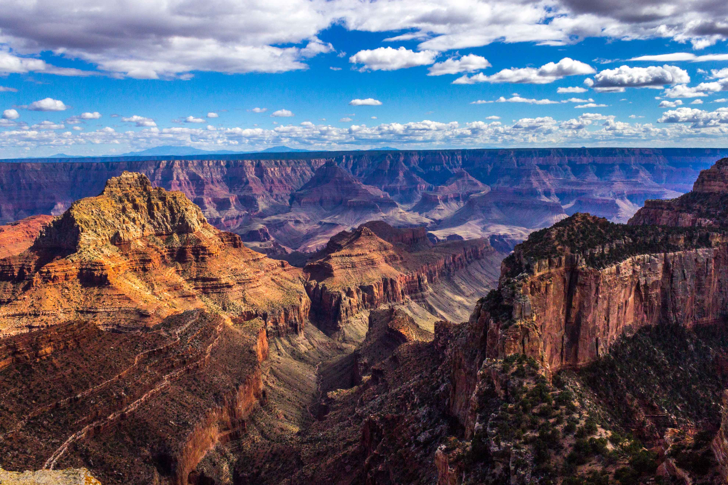
Grand Canyon National Park (Eng. Grand Canyon National Park) - one of the oldest national parks in the United States, located in Arizona. It’s one of the recognized natural wonders in the world. The park’s area is 4927 km².

Slide 4
The Grand Canyon was formed by the mighty Colorado River cutting into a plateau in Arizona. The canyon is 277 miles long and about 1 mile deep. Because it's so deep, the top and the bottom have very different weather and vegetation. Going from the top to the bottom is somewhat like going from Canada to Mexico. The canyon is usually with stunning gold, pink, and purple bands of rock. Each of these bands is a stratum, or layer of the earth's crust. Some strata took over 170 million years to form.
Today millions visit the Grand Canyon each year. Many come only for a quick look. But for those who want to explore the canyon, there are plenty of oppotunities.
You can explore the canyon by helicopter. You can hike down to the bottom of the canyon. It's a two-day round trip, and you must bring lots of water. But if you prefer, you can make this trip by mule. On foot or on muleback, you can also reach the village of the Havasupai, at the west end of the canyon.

Slide 5
What’s the area of the Grand Canyon?
Where is the Grand Canyon?
How long is the Grand Canyon?
How can visitors explore the Grand Canyon?

Slide 6
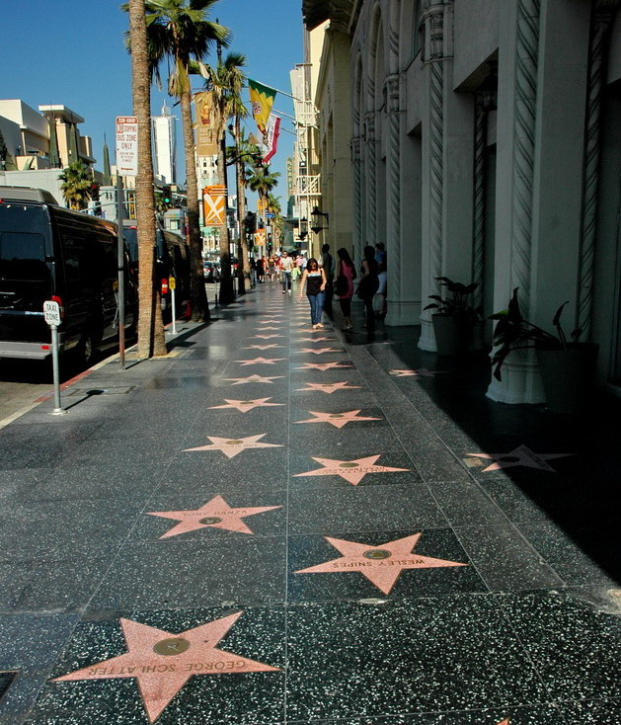
Hollywood Walk of Fame is considered one of the business cards of Los Angeles. This alley is known for having many stars in its sidewalks with the names of the most famous Hollywood artists.

Slide 7
Today, the Walk of Fame stretched for 15 blocks on both sides of Hollywood Boulevard and Wine Street. Undoubtedly, this show business monument is one of the most successful marketing moves ever created. Every Hollywood actor, musician or TV presenter, wants to see his name on this famous alley, and there are more than 10 million people willing to walk along it.

Slide 8
What is alley known for?
How many blocks are there on the Walk of Fame?
Where is the Walk of Fame?
How many people visit the Walk of Fame?

Slide 9
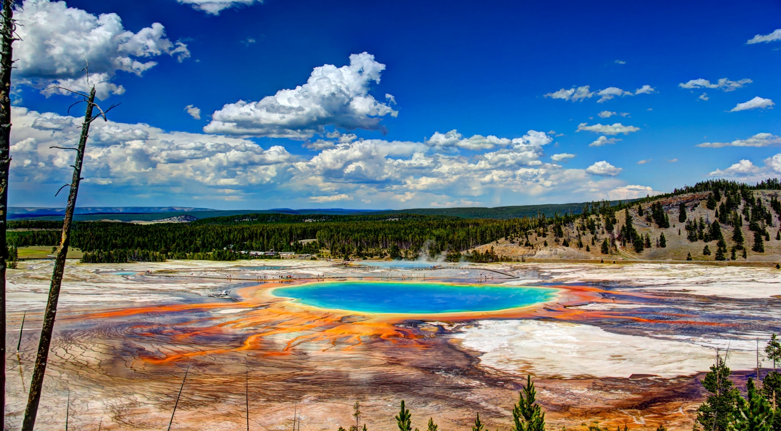
Yellowstone is a national park and biosphere reserve in the northwestern United States, protected by UNESCO. It is located on the territory of three states at once: Wyoming (the largest part), Idaho and Montana.

Slide 10
Yellowstone National Park, the oldest national park in the world, is famous for its many natural wonders. The park has more geysers and hot springs than any other area in the world. Yellowstone's scenic attractions include deep canyons, thundering waterfalls, sparkling lakes, and vast evergreen forests broken by rolling meadows. Yellowstone is also one of the largest wildlife preserves in the United States. It has a greater concentration of large and small animals than any other area in the United States except Alaska.

Slide 11
Where is Yellowstone?
What is Yellowstone famous for?

Slide 12
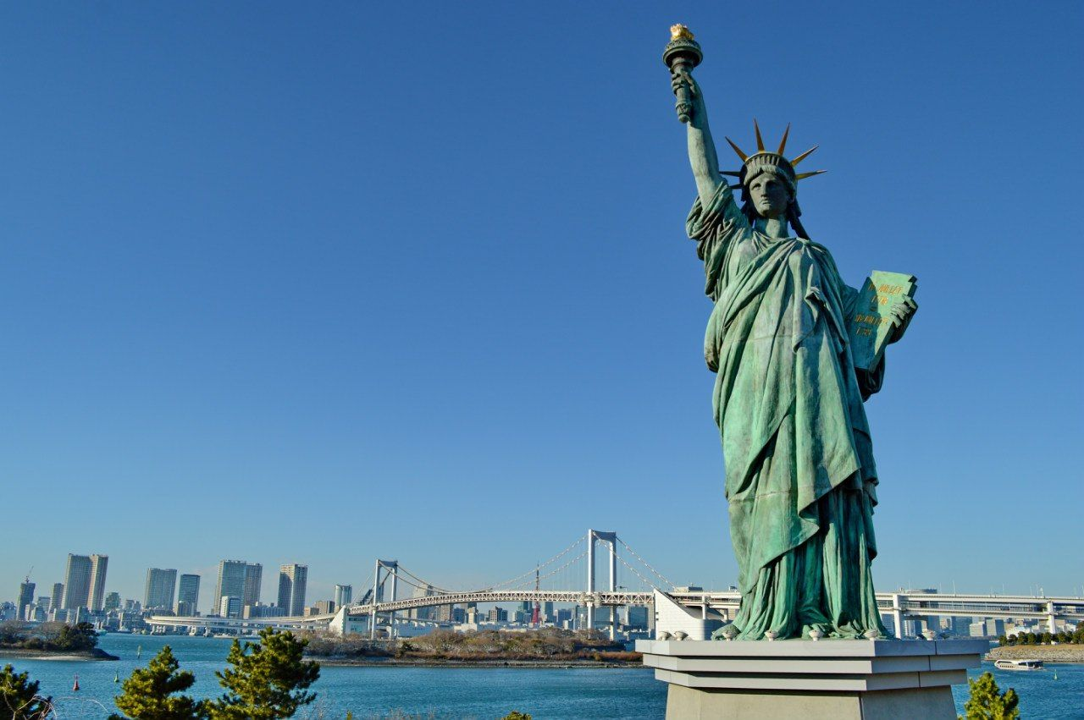
Statue of Liberty, full name - Freedom, illuminating the world, Eng. Liberty Enlightening the World) - one of the most famous sculptures in the US and in the world, often called "the symbol of New York and the USA", and democracy”,“ Lady Liberty ”. The Statue of Liberty is one of the most famous monuments of the USA.

Slide 13
The people of France gave the Statue to the people of the US in 1886 in recognition of their friendship. The statue is situated on the Liberty Island in New York. It is 93 meters high and weighs more than 200 tons. The statue stands on the platform inside which there is a museum dedicated to the history of immigration to the US.
The crown of the statue is also a viewing platform which is open to visitors. However, you will have to overpass 356 steps to reach it. Nevertheless, the view from the top of the statue is stunning. You will see the whole city and will admire its beauty and unique architecture.

Slide 14
What are the nicknames for the Statue of Liberty?
Who gave the statue to the people of the US?
How the crown of the statue is used?
What is inside the statue?

Slide 15
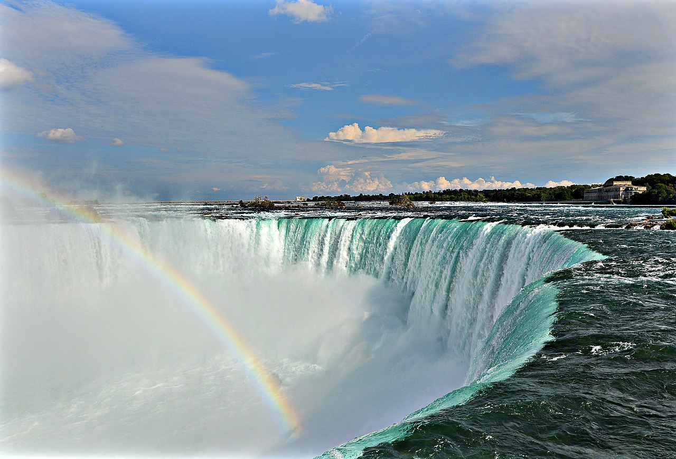
Despite the fact that Niagara Falls is located about 40 km from the city of Toronto, it is considered to be its main natural attraction. Niagara is one of the most amazing and picturesque waterfalls in the world. It takes its origin in the United States, but the most fascinating species went to Canada.

Slide 16
The sound of roaring water is heard for many kilometers around, it sounds especially frightening at night, so when you stand at the very waterfall you hear nothing at all. Its name is translated from the Indian dialect as "thundering water." "Niagara Falls" is a common name for three waterfalls – the American Falls, the Horseshoe Falls and the Bridal Veil Falls. Niagara Falls are not very high (53 metres) but very wide. Every year thousands of people visit this scenic place. There is the Rainbow Bridge over the river which connects both countries. It is open for pedestrians.

Slide 17
Where is Niagara Falls located?
What is the sound effect of the waterfalls?
What does the “Niagara Falls” mean?
How high is the Niagara Falls?

Slide 18
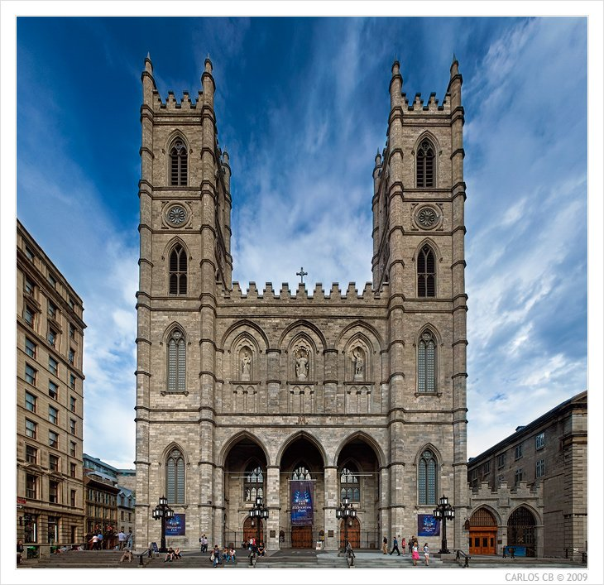
Notre Dame de Montreal - the oldest basilica in the old part of the city of Montreal, which has the status of a cathedral and is considered one of the most beautiful churches in Canada

Slide 19
The monumental neo-gothic temple rises to a height of 70 m, so it is clearly visible from afar. Notre Dame de Montreal is one of the main decorations of the Old City and is very popular among tourists. Since 1989, the Montreal Cathedral has the status of a national monument of Canada

Slide 20
Where is Notre Dame de Montreal?
What is Notre Dame de Montreal famous for?
How high is the temple?

Slide 21
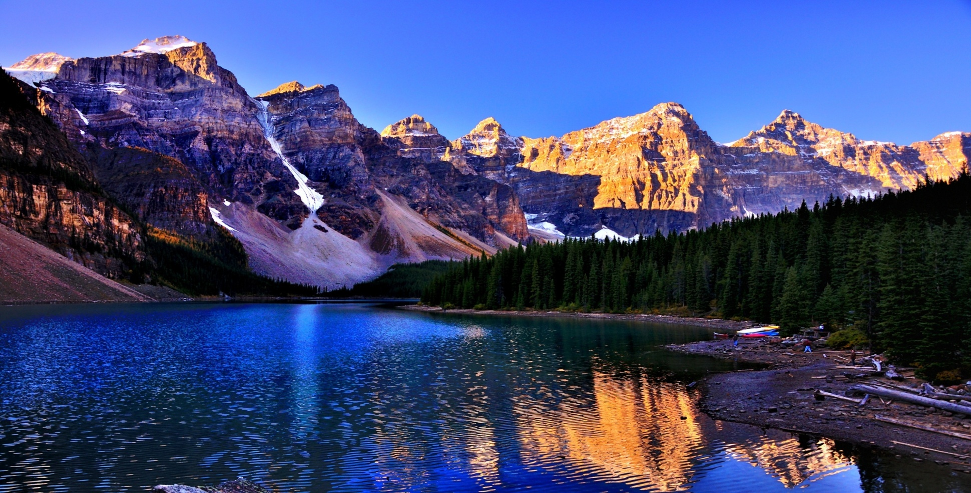
Banff National Park (Banff National Park) - one of the main natural attractions of Canada. Founded in 1885, it is the first and also the largest nature reserve in the country - its area is 6,641 square meters. km Since 1984 it has been included in the UNESCO World Heritage List.

Slide 22
Banff National Park is one of the most famous attractive tourist destinations in Alberta, the province of Canada. It’s not only a national treasure, but one of the parks in the Canadian Rockies. Visitors can hike, ski, camp, fish, ride a bike and simple relax there. The well-known Lake Louise is also within the park’s border.

Slide 23
When was the Banff National Park founded?
What’s the area of the Banff National Park?
What’s the Banff National Park famous for?
What can visitors do there?

Slide 24
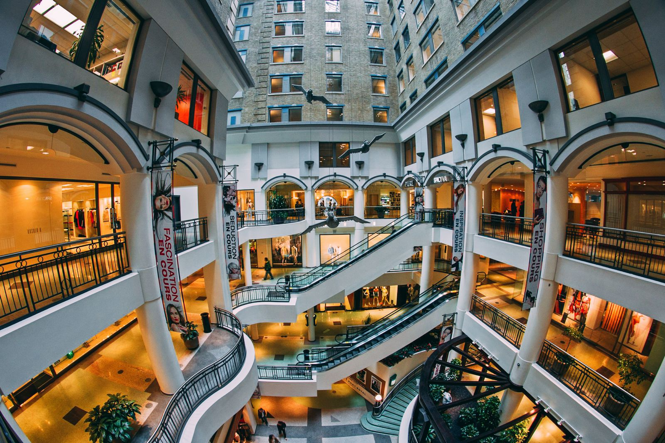
The Underground city is a popular attraction in Montreal. It is a huge space under the ground, consisting of winding tunnels, shops and metro stations. When visiting this place for the first time it seems as if it was in a large anthill, life in which doesn’t stop for a minute. In order not to get lost in the maze of corridors, tourists should carefully follow the signs.

Slide 25
Initially, this object was created to protect citizens from the scorching summer sun. Now the Underground city in Montreal is a huge commercial and business space of 30 km long and 10 floors high. There are 1500 shops and boutiques, about 200 restaurants, more than 30 cinemas, 1600 apartments, 10 metro stations ,a huge number of offices, concert halls, underground garages.

Slide 26
Why was the object created?
What does Underground city consist of?

Slide 27
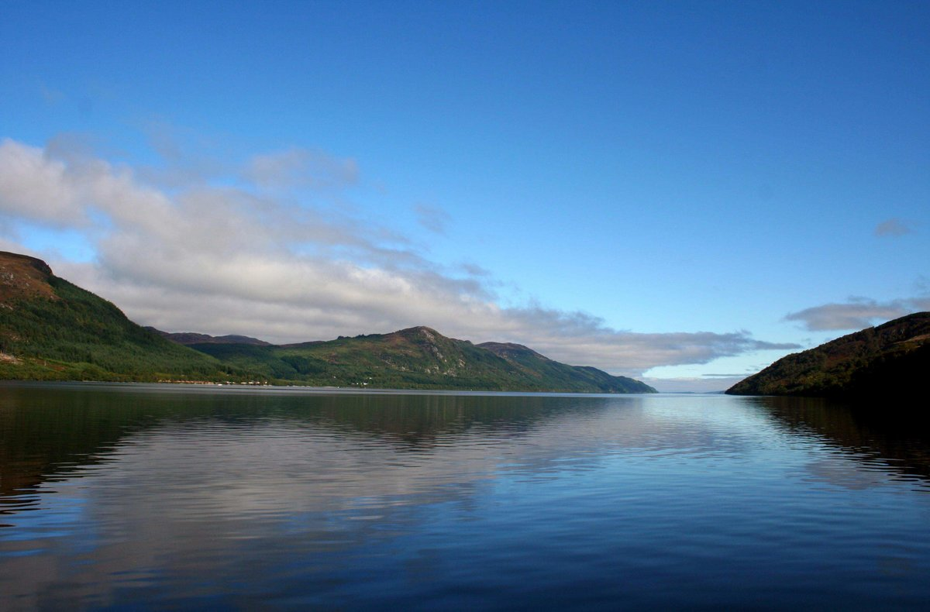
Loch Ness (eng. Loch Ness, Gaelic. Loch Nis)-a large deep freshwater lake in Scotland, stretching for 36 km South-West of Inverness. The lake is widely known in the world thanks to the legend of the Loch Ness monster. There are numerous commercial routes on the lake for tourists who want to enjoy the beautiful nature and possibly see the mythical monster.

Slide 28
Loch Ness is the largest body of water throughout the great Glen geological fault, extending from North to South from Inverness to Fort William. The lake is a part of the Caledonian canal, which connects the Western and Eastern coasts of Scotland. Loch Ness, like many other lakes in this part of Scotland, glacial origin. The lake is quite long and deep, while its water is very muddy, due to the high peat content in the soil.

Slide 29
What is the Loch Ness Famous for?
Where is the Loch Ness located?
Why is water in the lake muddy?

Slide 30
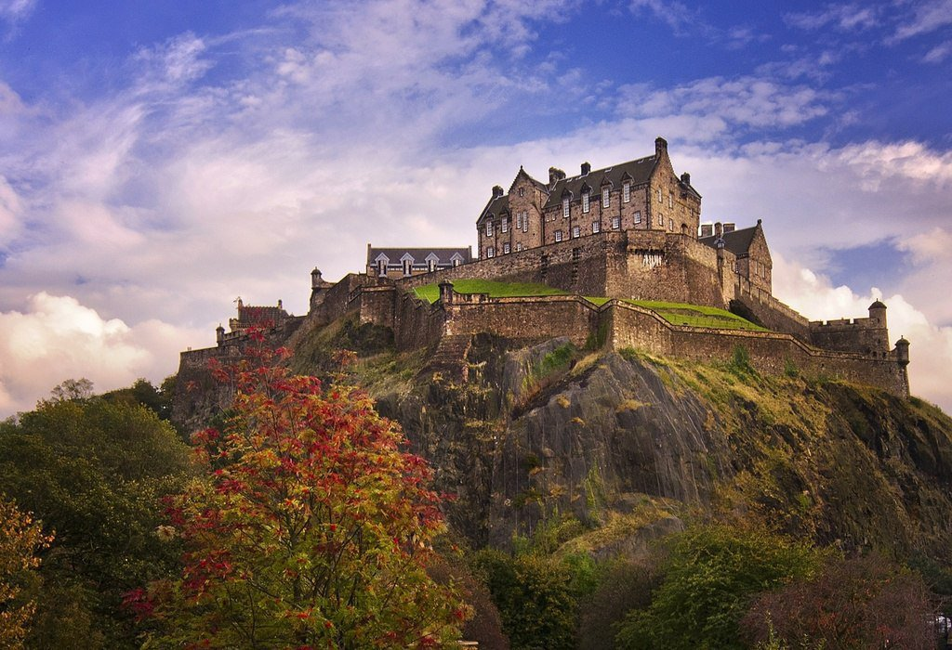
Edinburgh castle (eng. Edinburgh Castle) — an ancient fortress on the Castle rock in the center of the Scottish capital-Edinburgh. Until recently, it was at the disposal of the British Ministry of defense.

Slide 31
The castle is open to the public and is Edinburgh's main tourist attraction. Edinburgh Castle is a stronghold that was once the residence of Scottish monarchs and now serves mostly as a museum. It stands 443 feet (135 metres) above sea level and overlooks the city of Edinburgh from a volcanic crag called Castle Rock. Castle Rock has been the site of human activity for at least 3,000 years.

Slide 32
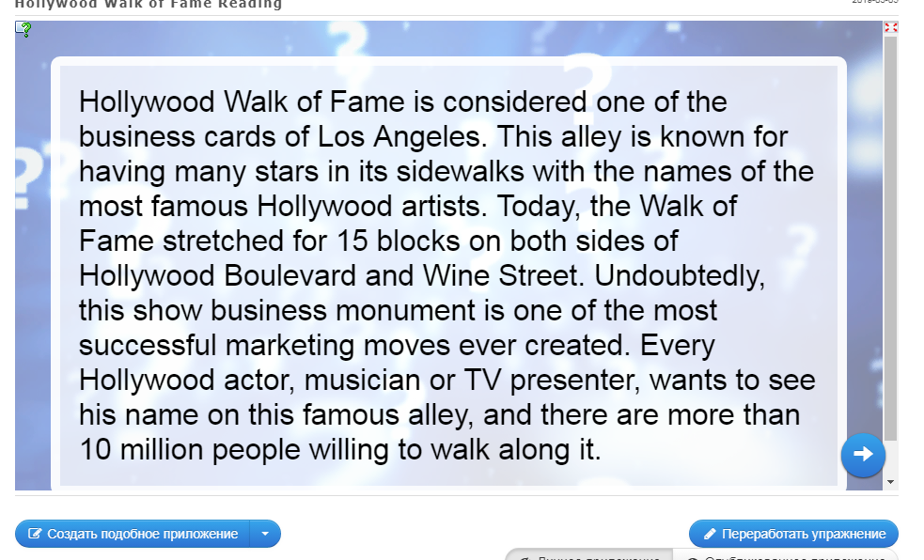

Slide 33
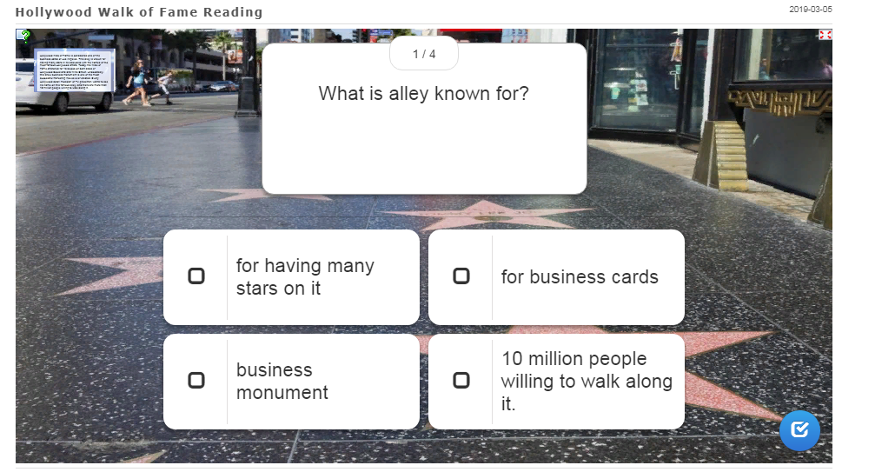

Slide 34


Slide 35


Slide 36


Slide 37
Результаты анкетирования
Нужна ли такая электронная презентация на уроках английского языка? Да-100% Нет-0%
Поможет ли Вам презентация при подготовке к урокам английского языка? Да-80% Нет-20%
Экономит ли данная презентация ваше время при подготовке к урокам? Да-60% Нет-40%
Понравилась ли Вам данная презентация? Да-100% Нет-0%
Что понравилось больше всего? Содержание-46,6% Оформление-33,4% Интернет-ресурс-20%
Хотели бы Вы что-нибудь добавить или изменить? Да-86,6% Нет-13,4%

